Slide 1
Estimation with Uncertainty
Analysis of Biological Data
Chapter 4

Slide 2
Key Learning Objectives
Understand that because estimates take values by chance, they will differ from true population parameters.
Connect the spread of the sampling distribution to uncertainty in estimates.
Recognize the standard error as the standard deviation of the sampling distribution.
Understand the confidence interval as a plausible range of a parameter, given an estimate and uncertainty in it.

Slide 3
Samples Take Their Value by Chance
Sets of samples from the same distribution can be different.
Therefore, estimates obtained from samples from the same population can differ by chance.

Slide 4
Sampling

Slide 5
Sampling, What’s the point?
We sample because we cannot measure the entire population.
When we take samples, we cannot see the sampling distribution.
Still, considering the process of sampling allows us to quantify the uncertainty in estimates.

Slide 6
Two Ways to Conceptualize Sampling
Here are the two right* ways to think about the process of taking a sample from a population.
If you had a full population and made an estimate from a sample of size n.
Think about the PROCESS that generates your population data, what would a sample generated by this process look like? (e.g. flipping a coin).
* But sometimes one is more convenient than the other.

Slide 7
Getting a feel for sampling

Slide 8
Generating a Sample From a Population
In two easy steps:
Take a sample of size n.
Calculate the parameter estimates.
This is how we do science.

Slide 9
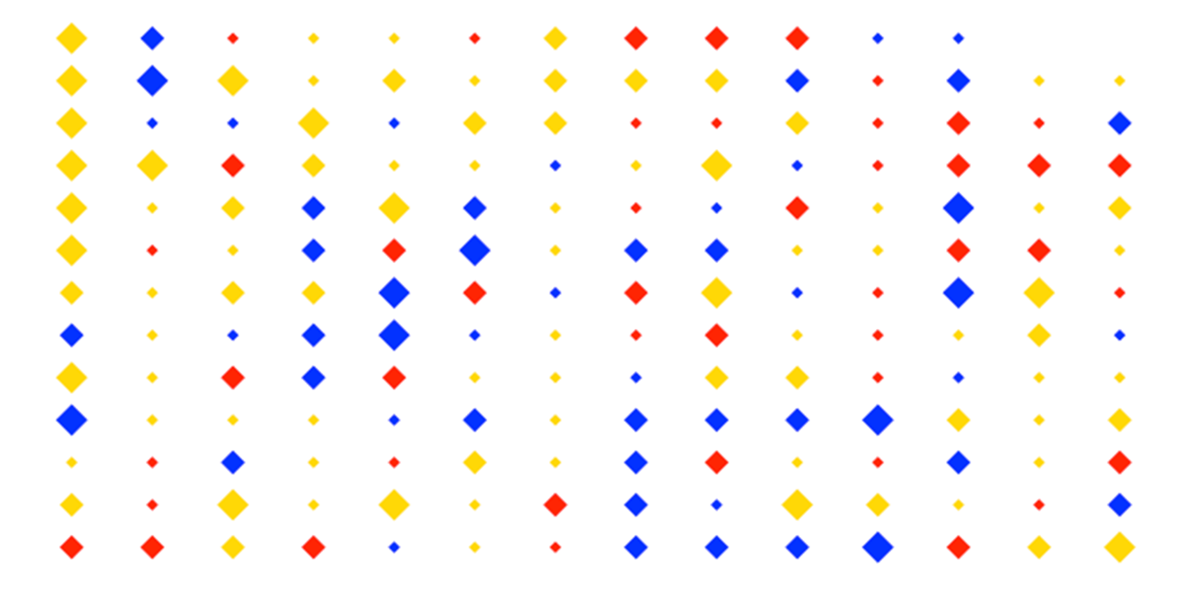
A Population of Diamonds
A population of 180 diamonds of different sizes and colors.

Slide 10
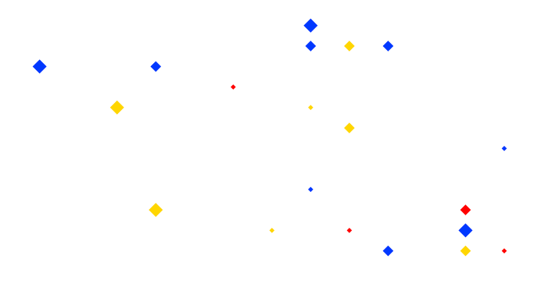
A Sample of 20 Diamonds
 | Small | Medium | Large
Blue | 2 | 4 | 3
Gold | 2 | 3 | 2
Red | 3 | 1 | 0

Slide 11
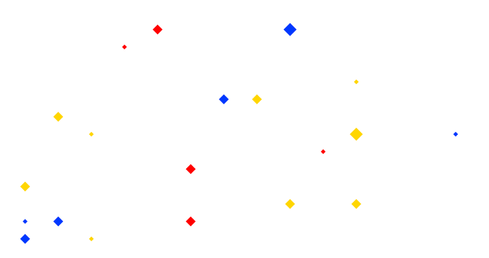
Another Sample of 20 Diamonds
 | Small | Medium | Large
Blue | 2 | 3 | 1
Gold | 3 | 5 | 1
Red | 2 | 3 | 0

Slide 12
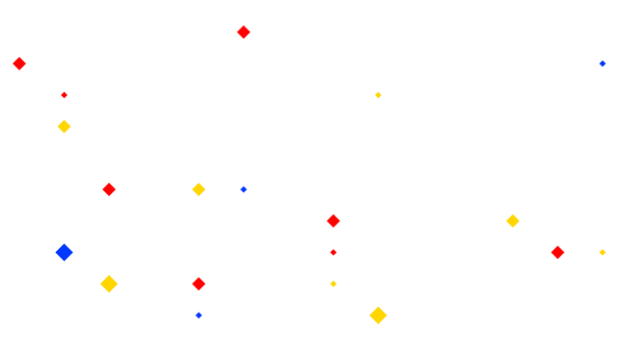
And Another Sample of 20 Diamonds
 | Small | Medium | Large
Blue | 3 | 0 | 1
Gold | 3 | 3 | 2
Red | 2 | 6 | 0

Slide 13
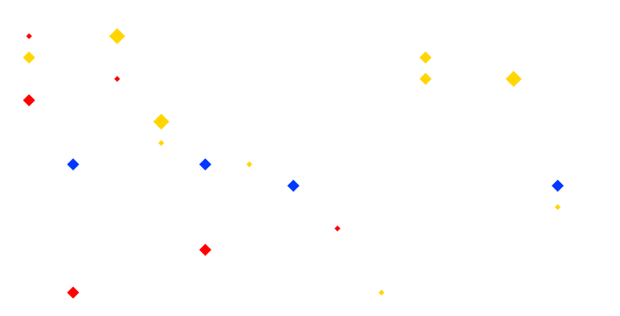
One Last Sample of 20 Diamonds
 | Small | Medium | Large
Blue | 0 | 4 | 0
Gold | 4 | 3 | 3
Red | 3 | 3 | 0

Slide 14
Sampling Diamonds: Lessons Learned
1. “Sampling is random”:
Estimates from sampling efforts varied and did not perfectly capture the true population values.
2. Random DOES NOT mean that all outcomes are equally probable e.g.
There are no LARGE RED diamonds in the population so we never sampled a LARGE RED diamond.
The most common diamond color in the population is gold. Gold is often the most common color in a sample.

Slide 15
The sampling distribution!

Slide 16
The Sampling Distribution
The sampling distribution is the distribution of the parameter estimate of interest from these samples.

Slide 17
Generating A Sampling Distribution
In three easy steps:
Take a random sample of size n.
Calculate the parameter estimates.
Go back to (1) & repeat many times
In actual analyses, we would never do this, but it’s good think through this to make our thoughts concrete.

Slide 18
The Sampling Distribution of Diamonds
rep | Small blue | Small gold | Small red | Medium blue | Medium gold | Medium red | Large blue | Large gold | Large red
1 | 2 | 2 | 3 | 4 | 3 | 1 | 3 | 2 | 0
2 | 2 | 3 | 2 | 3 | 5 | 3 | 1 | 1 | 0
3 | 3 | 3 | 2 | 0 | 3 | 6 | 1 | 2 | 0
4 | 0 | 4 | 3 | 4 | 3 | 3 | 0 | 3 | 0
5 | 4 | 4 | 3 | 2 | 4 | 1 | 1 | 1 | 0
6 | 3 | 4 | 2 | 4 | 0 | 2 | 0 | 5 | 0
7 | 1 | 7 | 1 | 1 | 5 | 2 | 1 | 2 | 0
8 | 2 | 3 | 5 | 3 | 2 | 2 | 1 | 2 | 0
9 | 0 | 4 | 4 | 4 | 2 | 4 | 1 | 1 | 0
…
1000 | 1 | 3 | 2 | 3 | 5 | 0 | 3 | 3 | 0

Slide 19
The Sampling Distribution of Diamond Size

Slide 20
The Sampling Distribution of Small Gold Diamonds

Slide 21
The Joint Sampling Distribution

Slide 22
Variability in Estimates Decreases with N

Slide 23
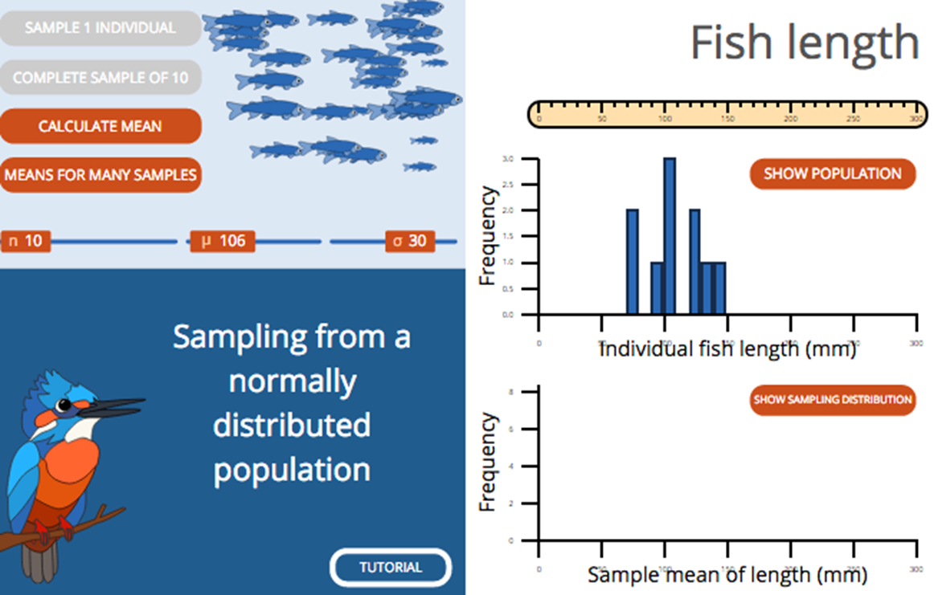
Sampling Distribution: Book’s Web App.
Let’s look at the web app from the book link

Slide 24
Standard error

Slide 25
The Standard Error: Definition
The standard error of an estimate is the standard deviation of its sampling distribution.
The standard error predicts the sampling error of the estimate.

Slide 26
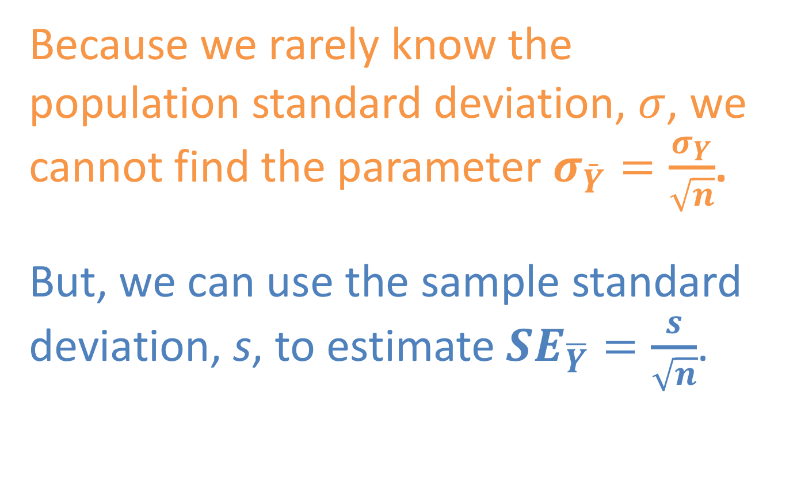
Standard Error: Key Math & Concepts
Because we rarely know the population standard deviation, $σ$, we cannot find the parameter $σ_{\bar{Y}}=\frac{σ_{Y}}{\sqrt{n}}$.
But, we can use the sample standard deviation, s, to estimate ${SE}_{\overline{Y}}=\frac{s}{\sqrt{n}}$.

Slide 27
The standard error: Example: Uncertainty in the mean height of NBA players

Slide 28
🏀 Sampling Basketball Players 🏀
The heights of NBA players in 2014 is a fully characterized population.

Slide 29
Generate a Sample From the Population
A random sample of heights of five NBA players (Right).
The sample mean height is
(83 + 79 + 74 + 85 + 72) / 5
= 78.8 inches.
Player | Height (inches)
1 | 83
2 | 79
3 | 74
4 | 85
5 | 73
# Example R code
library(infer)
sample.heights1 %>%
rep_sample_n(size=5, replace = F, reps =1)

Slide 30
Generating the Sampling Dist. of NBA Heights
By repeating this process of sampling many times.
More formally, the mean of means is the “grand mean”, not the ”mean mean.”

Slide 31
Compare: Population to Sampling Distribution
Mean parameter estimates of a sampling distribution should equal population parameters.
The width of a population exceeds that of its sampling distribution.

Slide 32
The Standard Error & The Sampling Distribution
The standard error is the standard deviation
of the sampling distribution.
The standard deviation of the distribution on the right is 1.53.

Slide 33
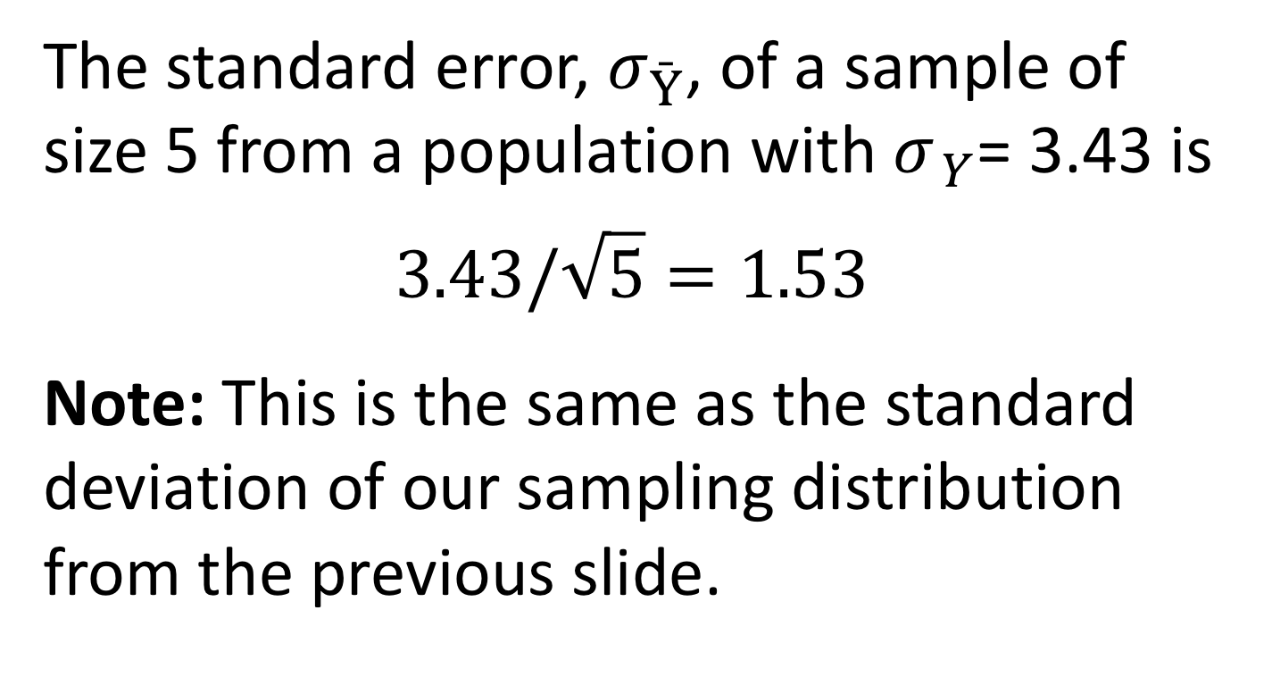

Comparing s_{sampling distribution} to $σ_{x}/\sqrt{n}$
The standard error, $σ_{\bar{Y}}$, of a sample of size 5 from a population with${ σ}_{ Y}$= 3.43 is
$$3.43/\sqrt{5}=1.53$$
Note: This is the same as the standard deviation of our sampling distribution from the previous slide.

Slide 34
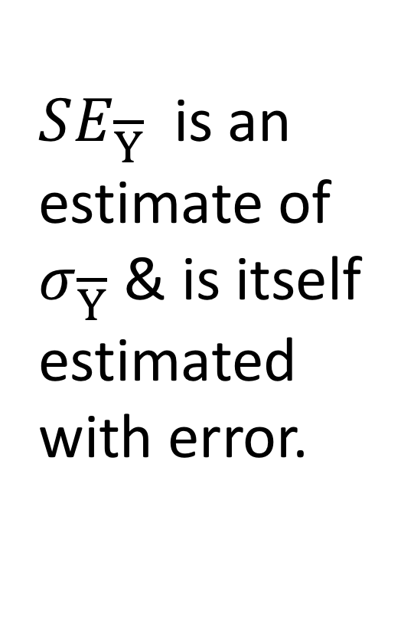
Estimating the Standard Error
$SE_{\overline{Y}}$ is an estimate of $σ_{\overline{Y}}$ & is itself estimated with error.

Slide 35
Sample size, uncertainty, and the Standard Error

Slide 36
SE Decreases with Sample Size
The standard error goes down as a sample size goes up.

Slide 37
Small Samples, Large Uncertainty slide 1/3
Uncertainty increases as sample size decreases.
Therefore, extreme values are often associated with small sample size.
Example: baseball pitchers performance (reported as ERA).

Slide 38
Small Samples, Large Uncertainty slide 2/3
Pitchers with the lowest ERAs tended to face the fewest batters.

Slide 39
Small Samples, Large Uncertainty slide 3/3
Pitchers with the highest era’s tended to face the fewest batters.

Slide 40
Lessons: Small Samples, Large Uncertainty
Treat simple summary statistics with skepticism.
Be sure to consider uncertainty before being misled by exceptional values.

Slide 41
Confidence Intervals Plausible values of a parameter

Slide 42
Confidence Intervals (CI’s)
Values for the parameter lying within the confidence interval are plausible, given the data and our agreed upon confidence.
Values for the parameter lying outside the interval are less plausible, given the data and our agreed upon confidence.

Slide 43
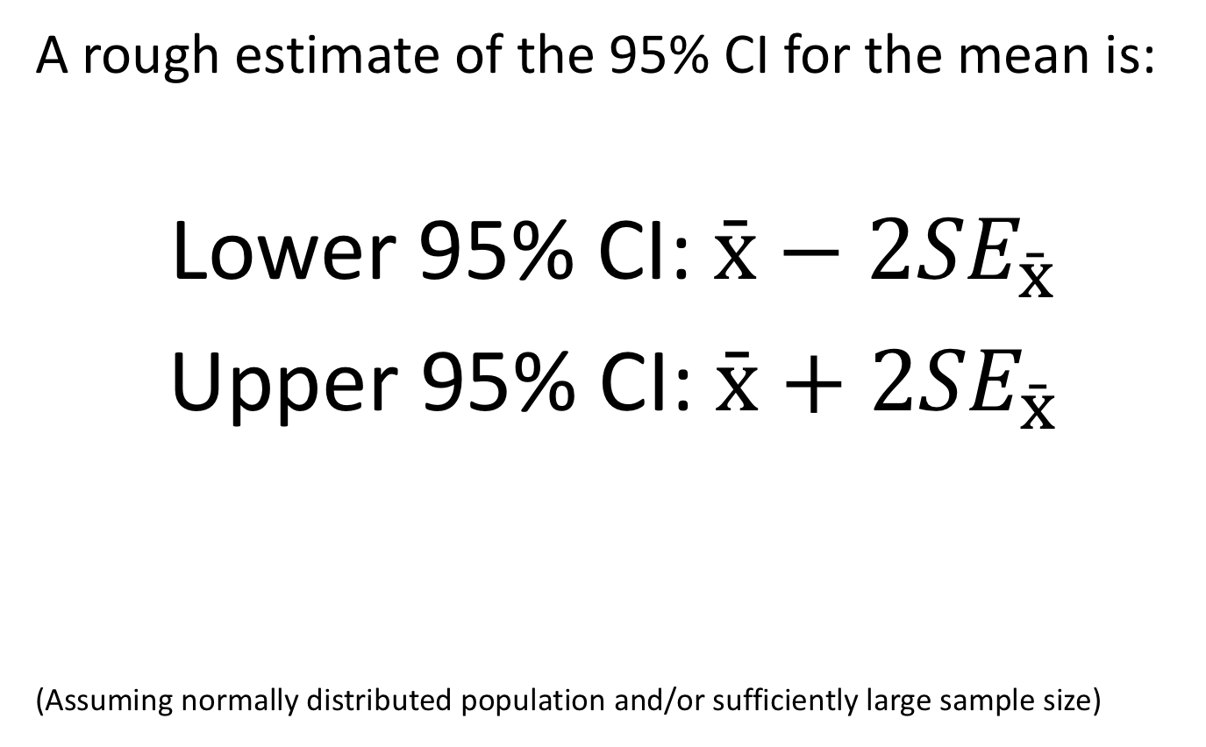
The 2SE Rule of Thumb
A rough estimate of the 95% CI for the mean is:
Lower 95% CI: $\bar{x}−2{SE}_{\bar{x}}$
Upper 95% CI: $\bar{x}+2{SE}_{\bar{x}}$
(Assuming normally distributed population and/or sufficiently large sample size)

Slide 44
Visualizing 95% Confidence Intervals

Slide 45
Interpreting Confidence Intervals
Correct 👍
95% of 95% confidence intervals calculated from samples include the population mean.
Also correct 👍
We are 95% confident that the population mean lies within the 95% confidence interval.
Not correct 👎
There’s a 95% probability that the population mean is within the 95% confidence interval.

Slide 46
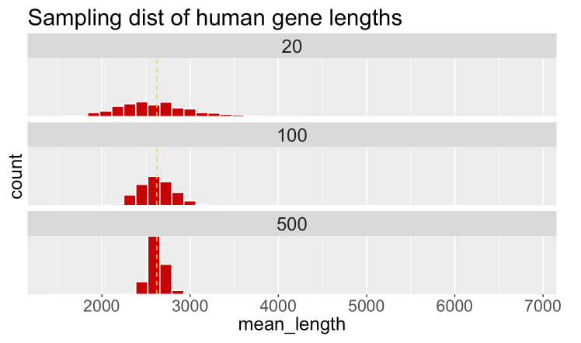
Example: Human Gene Lengths

Slide 47
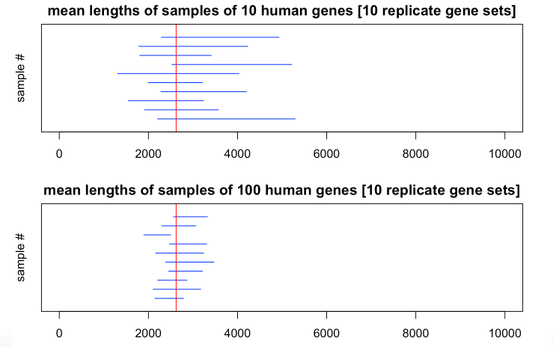
95% CI for Mean Human Gene Length

Slide 48
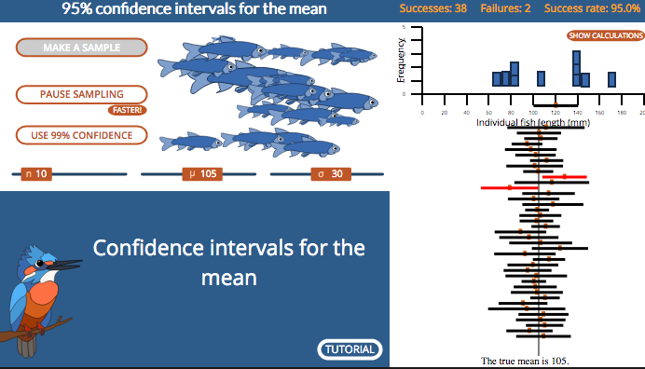
Confidence Intervals: Book’s Web App.
Let’s look at the web app from the book link

Slide 49
Pseudoreplication When your confidence is undeserved

Slide 50
What is Pseudoreplication?
Pseudoreplication is the error that occurs when samples are not independent, but they are treated as though they are.
Thus the sample size is smaller than claimed.
Pseudoreplication provides a false sense of high certainty.

Slide 51
Example: Pseudoreplication
You are interested in estimating the average pulse rate of mountain climbers.
Since they are hard to find, you decide to take 10 measurements from each climber.
You study 6 climbers, so you have 60 measures.
What is your sample size (n)?

Slide 52
Avoiding Pseudoreplication
You are interested in estimating the average pulse rate of mountain climbers.
Since they are hard to find, you decide to take 10 measurements from each climber.
You study 6 climbers, so you have 60 measures
Take the mean for each climber, so that you have 6 pulse rates, one for each climber (n=6).

Slide 53
Estimation Uncertainty Summary

Slide 54
Key Points
Parameter estimates are influenced by chance.
The sampling distribution considers what could have happened upon sampling.
The standard error is the standard deviation of the sampling distribution.
Confidence intervals bound plausible parameter values.
Uncertainty decreases and precision increases with sample size.

